Slide 1
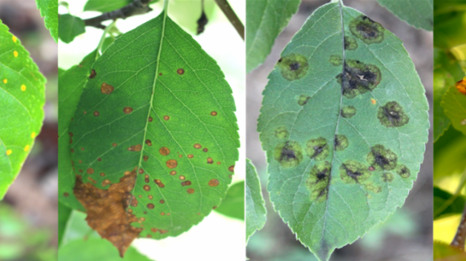
Plant Pathology 2021– Main Challenges
Guy Kabiri – 312252224
Tomer Dwek - 313229486
End date of the competition: June 2021
Course name: Introduction to computer vision – semester 2, 2021

Slide 2
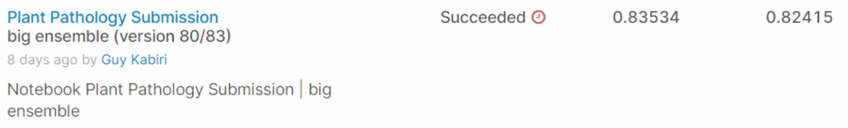
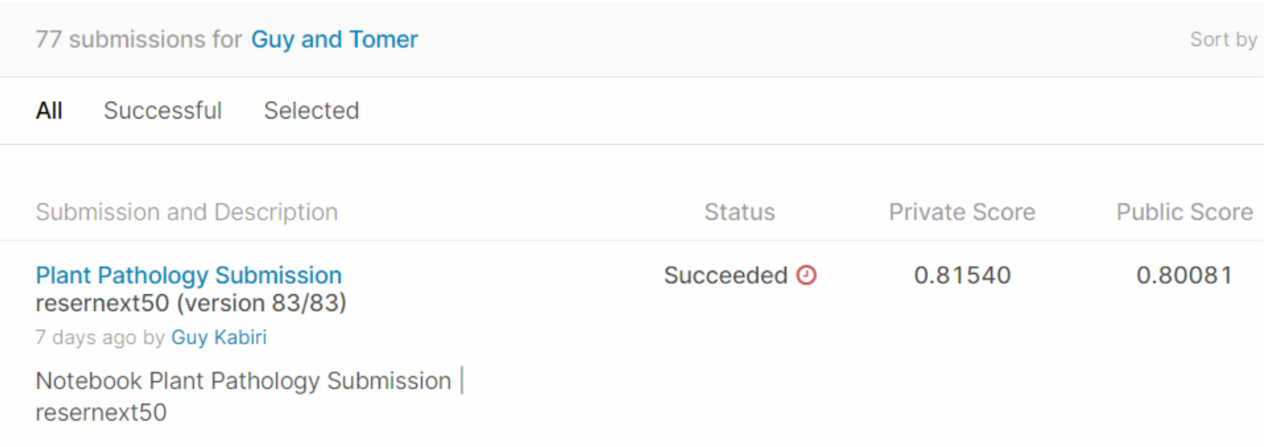
Best Submission
Last Submission & Number of Submissions

Slide 3
Our Solution
In our solution, we based on the materials we learned during the course.
We used Dataset and Dataloader to load handle a large amount of data.
In addition, we applied augmentations on the training images to improve our model performance.
In the training process, we implemented Optimizers, different loss functions, learning rate schedulers, cross-validation, transfer learning, and ensembles.
Moreover, to get better results we had to explore on our own more ways to fight over-fitting and get a better prediction model.
To achieve these results we read and applied about Batch-Normalization, different prediction models, Layer-Freezing, Multi-Label Classification, Voting Classifier, and how to synchronize our Colab notebook with Kaggle.
We found this information in the leading notebook in Kaggle, searching in Google, and a few articles.

Slide 4
Division of Labor
We did all the code writing and explanations together through Zoom sessions.
Beyond that, each of us searched separately for materials in Kaggle’s notebooks and Google searches and then we met and discussed the materials and techniques that we have found.

Slide 5
Main Challenges

Slide 6
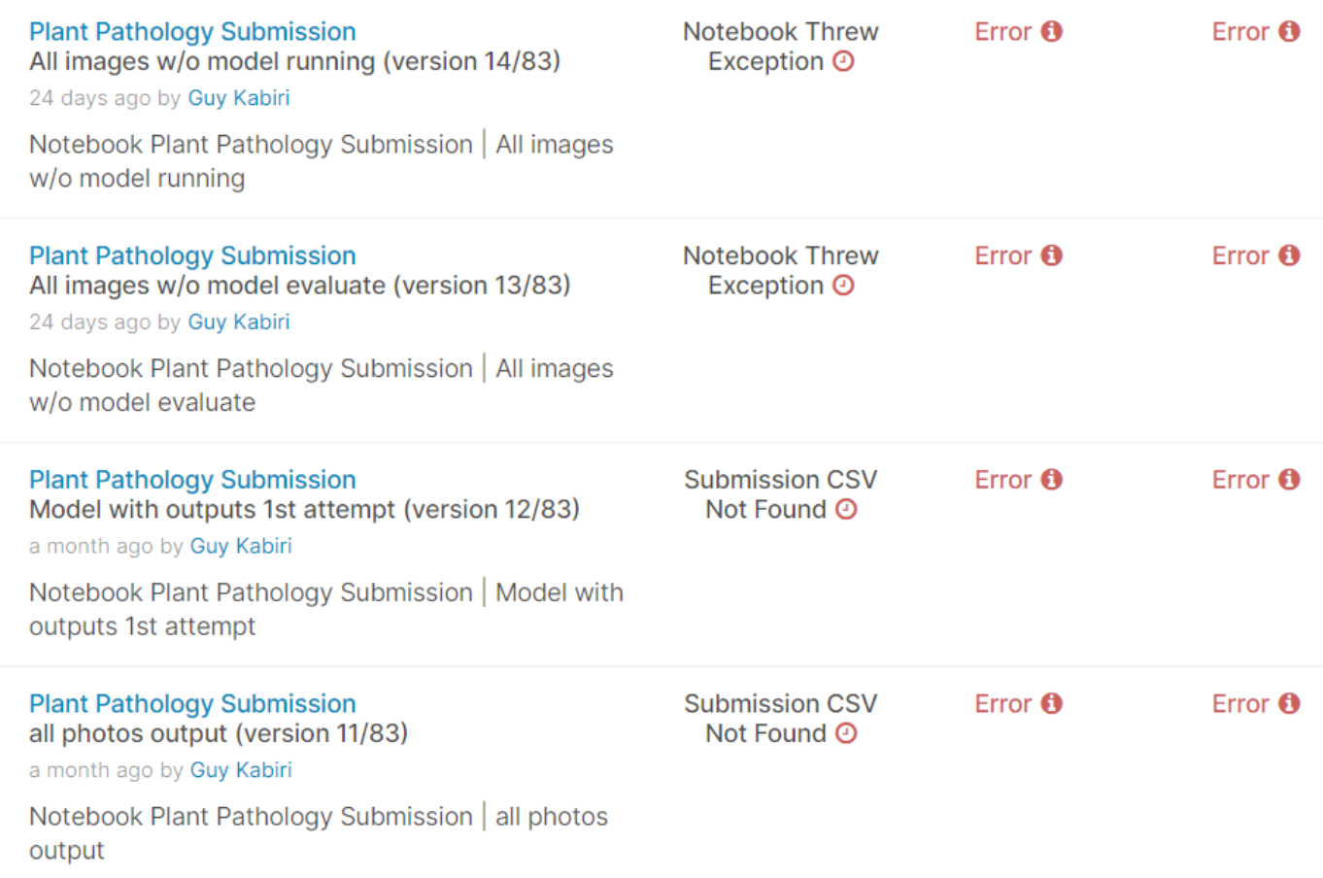
Error while submitting to Kaggle

Slide 7
Error while submitting to Kaggle
At first, we tried to submit basic notebooks to see how the submission process works but we faced some errors.
To solve these errors, we tried few changes in the data loading and in the way that we have created the CSV submission file.

Slide 8
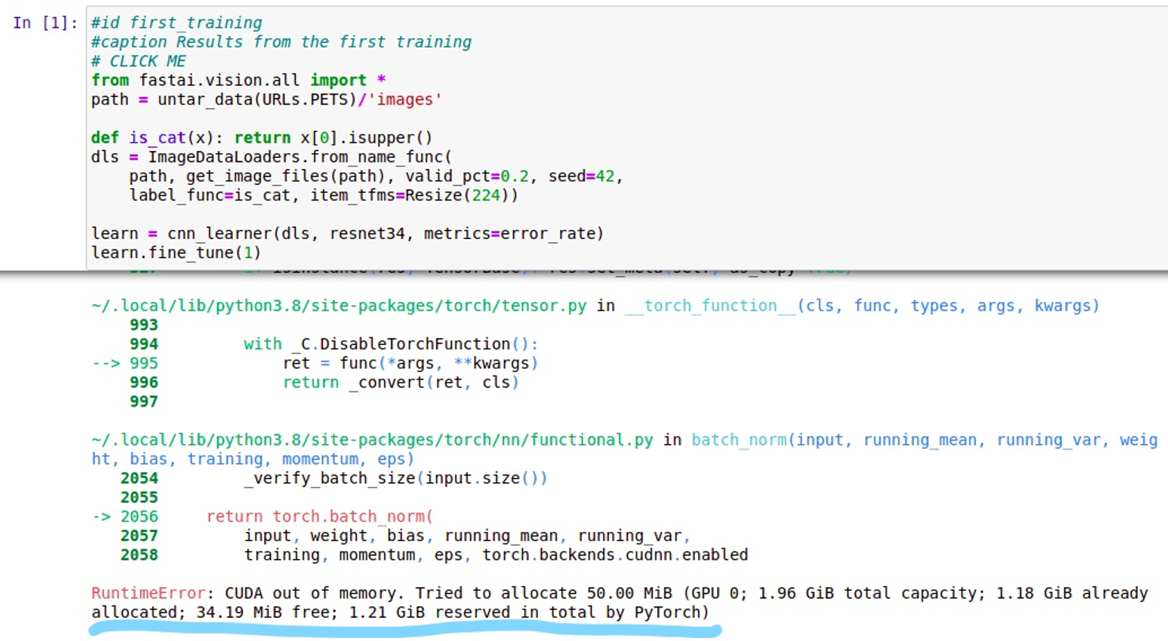
CUDA out of memory

Slide 9
CUDA out of memory
While training the models, the CUDA ran out of memory a lot of times.
To deal with this issue, we had to reduce the size of the mini-batch depends on the model’s number of parameters.
In some models, even this approach didn’t help because the model itself has a lot of parameters and that prevented us from training the model in a limited time.

Slide 10
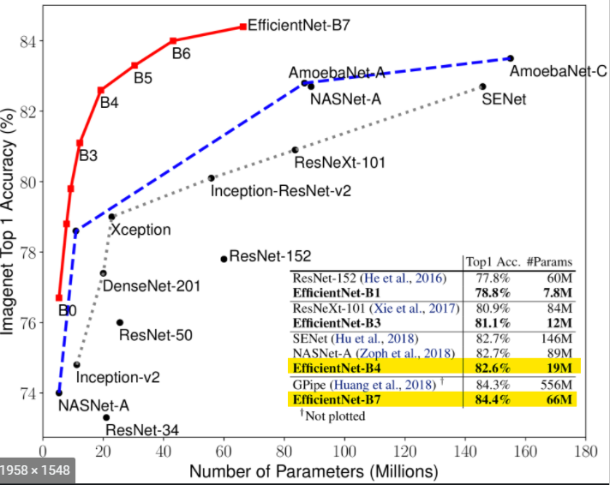
CUDA out of memory
For example: Efficientnet-B4 vs Efficientnet-B7 number of parameters

Slide 11
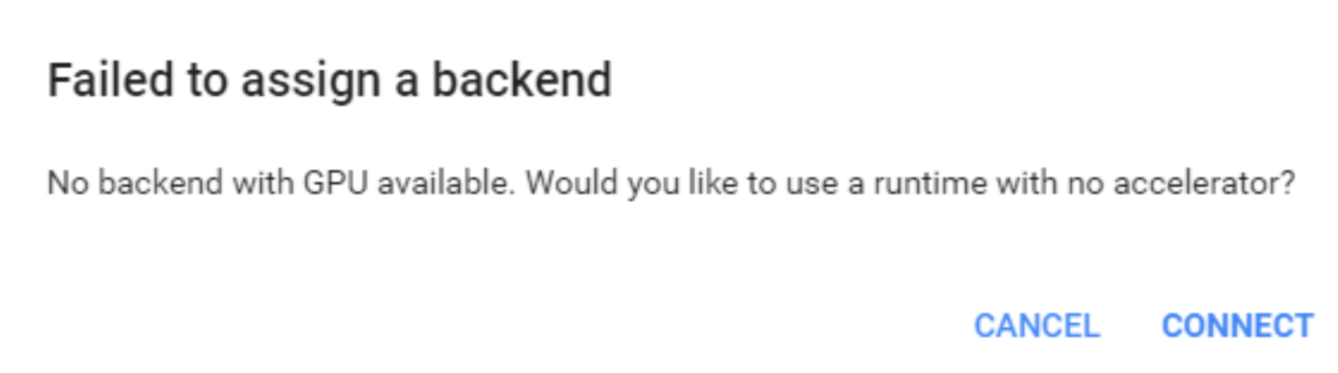
Colab GPU limitation
While training models, the Google Colab didn’t assign to us GPU after 1 training and even sometimes in the middle of training, we ran out of GPU. To deal with it we ran the notebook from different google accounts.

Slide 12
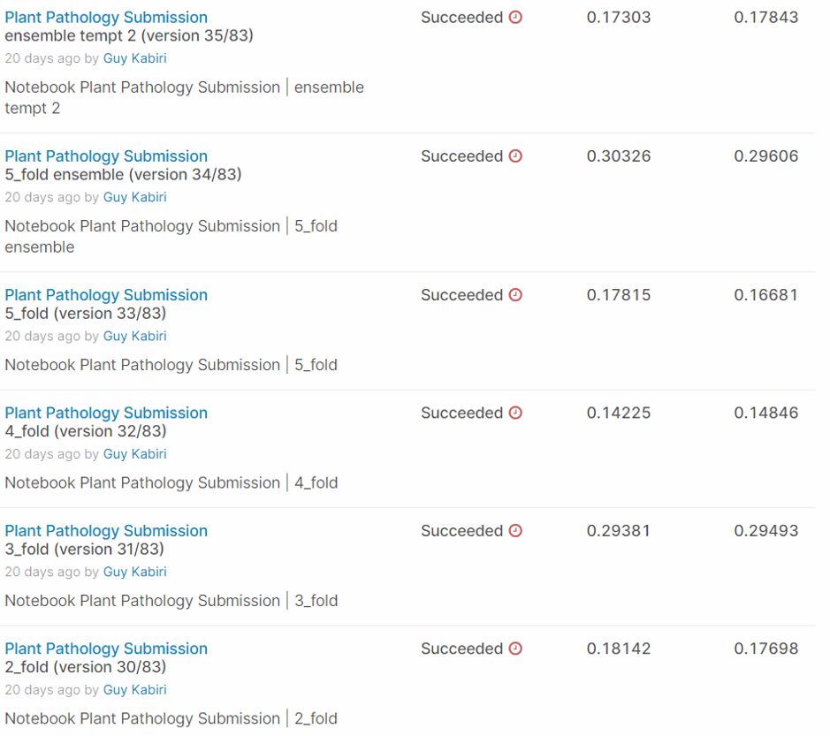
Over-fitting

Slide 13
Over-fitting
While training some models, the default model’s parameters lead us to over-fitting.
To deal with it, we tried many different hyperparameters, different loss functions, dropout layers, learning rate scheduling, transformations, and transfer learning.
Moreover, we read that freezing layers may help us also to fight overfitting problems.

Slide 14
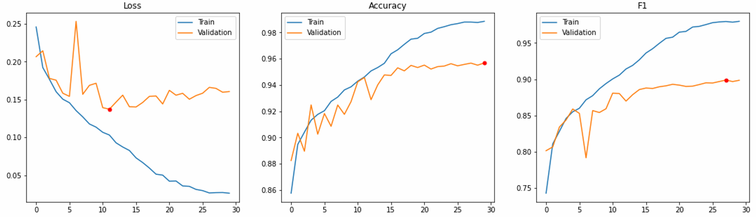
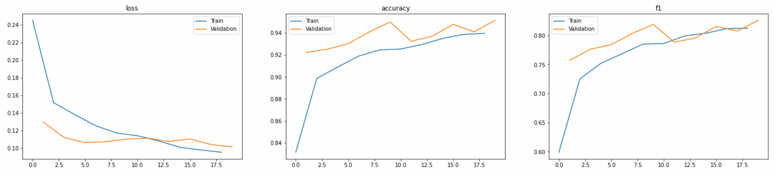
Over-fitting
For example: Efficientnet-B4 overfit model vs. good fit model

